Slide 1


AI final project
By Denys Ladden
and Emil B. Berglund

Slide 2


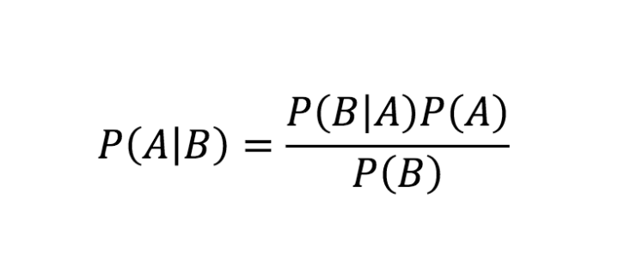
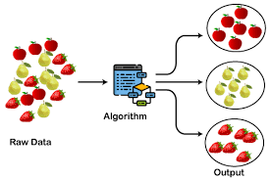
Naïve Bayes
Bayes Theorem
How and why it works?
Based on bayes theorem of conditional probability
Naïve because it assumes all variables are unrelated
Uses supervised learning method
Output variable is categorical, since it is a classification technique
Different NB versions depending on the input variable type

Slide 3
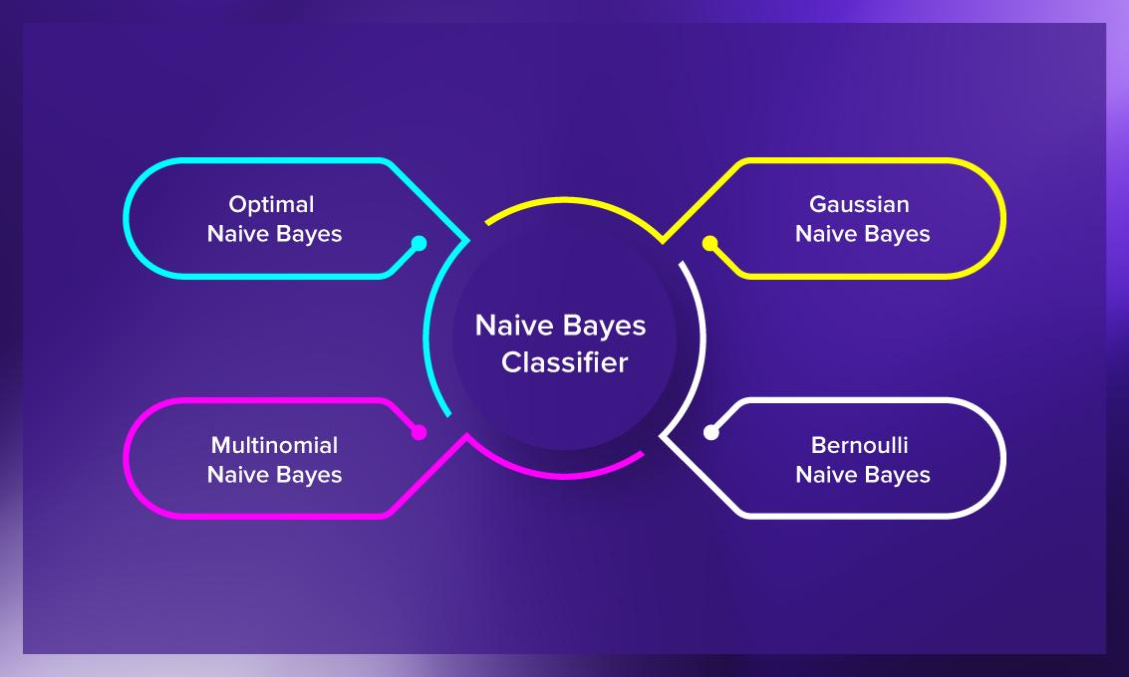
Types of Naïve Bayes
Gaussian
Continuous variables, assumes normal distribution. Example, our dataset.
Multinomial
Preferred when data is distributed multinomially. Constant p, unrelated repeated trials, discrete number of outcomes. Example, text classification.
Bernoulli
This one requires values to be binary valued, meaning they need to be categorical, for this one, dummy variables would be necessary in our dataset. Example, 10 coin tosses.
Applications:
* Real time prediction
* Multiclass prediction
* Text classification/filtering
* Recommendation systems

Slide 4

Advantages of Naïve Bayes
Its fast and highly scalable
It can be used for multiple types of classification
Very simple algorithm
Great on text classification
Works very well on even small datasets

Slide 5

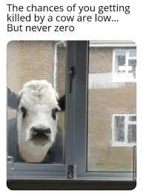
Disadvantages of Naïve Bayes
It’s naïve, meaning it assumes unrelated features, so it can learn the importance of these individual features, but not the relationship between them.
Zero-probability problem, (can be resolved by Laplacian correction).

Slide 6
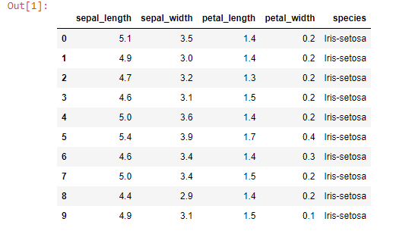
Introduction
The first 10 rows of the dataset
The database name: Iris Flower Dataset
The source of our dataset:
https://www.kaggle.com/arshid/iris-flower-dataset
Output variable, categorical:
Iris-subspecies
There are 4 predictor variables, all numerical:
Sepal length
Sepal width
Petal length
Petal width
GaussianNB model for our case

Slide 7
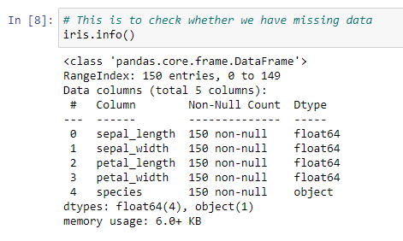
Step 1: Check and clean data
As you can see, all rows have the same number of entries (150) and there are non-null variables, meaning that the data is already cleaned and ready.

Slide 8
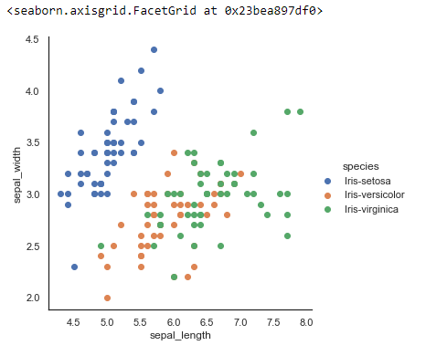
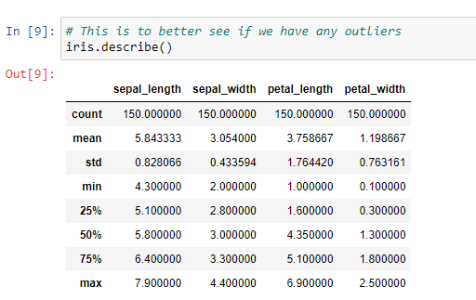
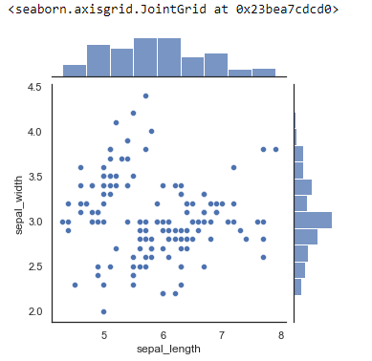
Step 2: Examine data for outliers

Slide 9
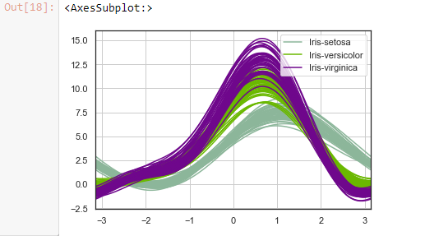
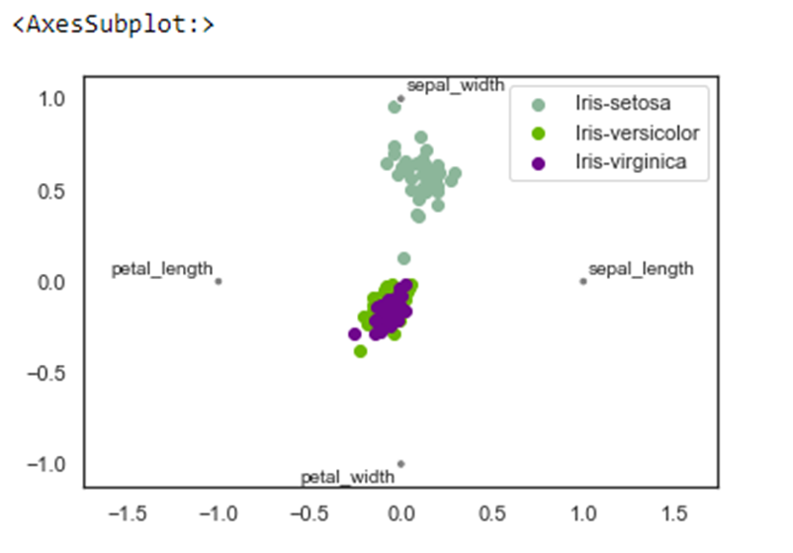
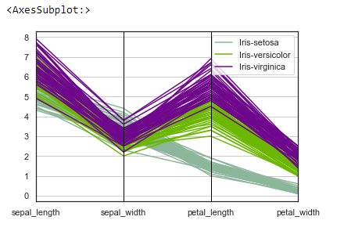
Step 3: Examining the data

Slide 10
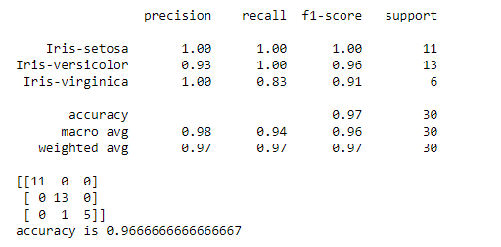
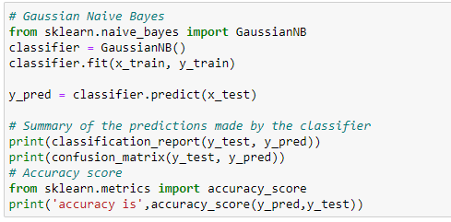
Step 4: Examining a model Gaussian NB

Slide 11
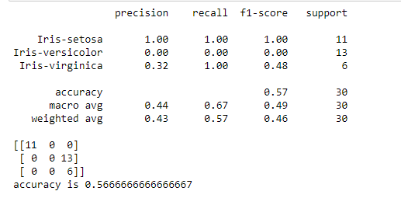
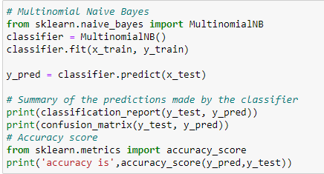
Step 4: Examining a model Multinomial NB

Slide 12
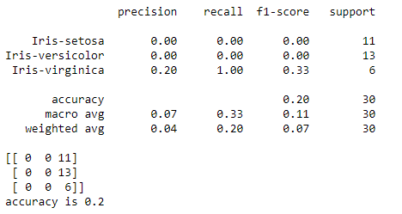
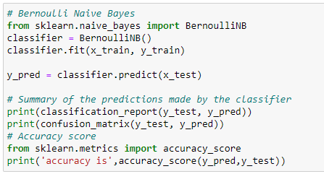
Step 4: Examining a model Bernoulli NB

Slide 13
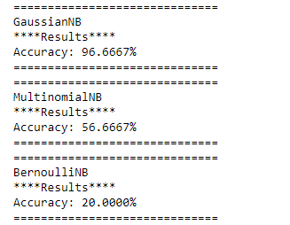
Step 5: Comparing the models
Here we can see the best model is the gaussian, and that makes sense since our dataset contains continuous variables. Since multinomial does categorical values, but since the input variables were continuous it converted the to categorical by classifying them into ranges.
The Bernoulli did the same thing as multinomial, however, it only classified into two categories, so it was way less accurate than the multinomial.

Slide 14
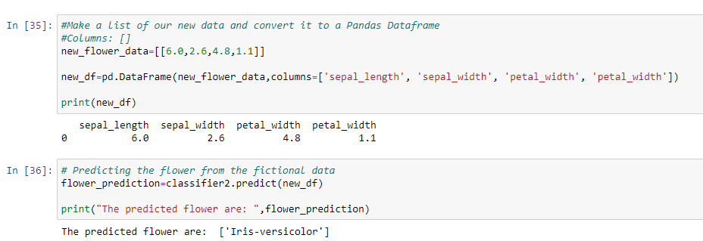
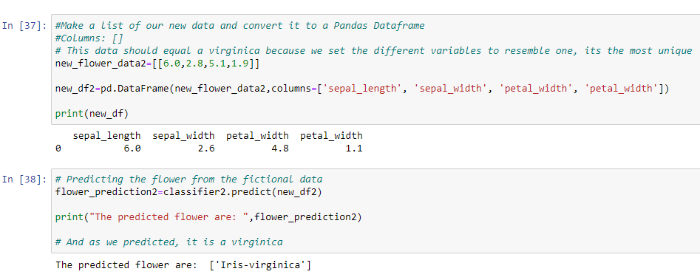
Step 8: Testing with new data
Here we used the gaussian model and created two new data tuples and then it predicted the species.
For the first one we just did random data , but for the second we chose data that would resemble an iris virginica, and it turned out to be correct.

Slide 15
Sources:
https://www.kaggle.com/arshid/iris-flower-dataset
https://machinelearningmastery.com/naive-bayes-classifier-scratch-python/
https://www.datacamp.com/community/tutorials/naive-bayes-scikit-learn
https://blog.floydhub.com/naive-bayes-for-machine-learning/
Videolink:
https://bellarmineonline.sharepoint.com/sites/AI_teamEBB_DL/Shared%20Documents/General/Recordings/New%20channel%20meeting-20211203_175133-Meeting%20Recording.mp4?web=1

